Slide 1
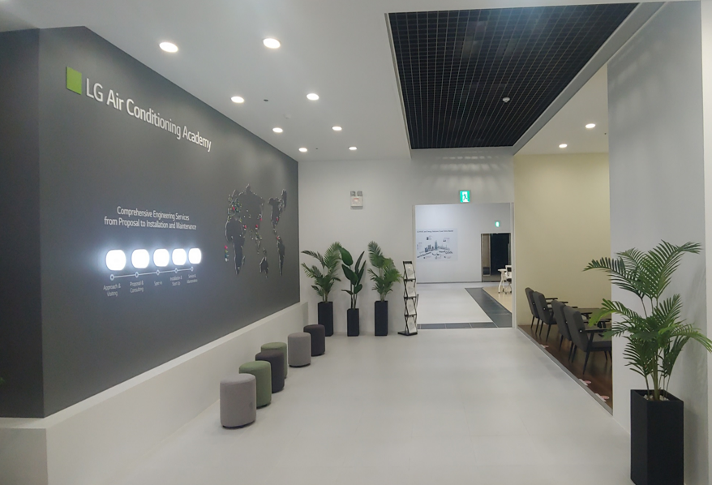


LG HVAC Training
LG HVAC Training
Copyright ⓒ LG Electronics. all right reserved.

Slide 2

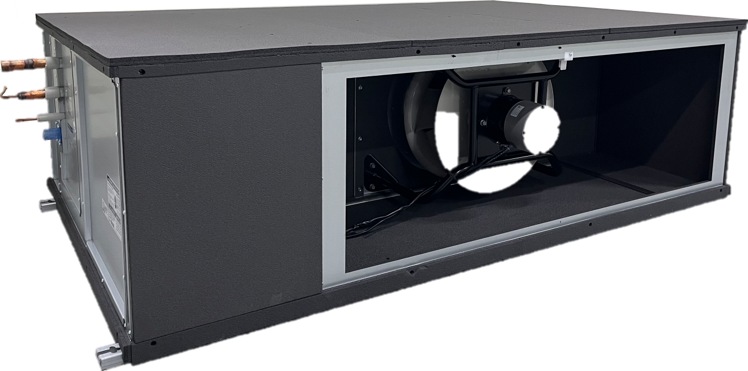
Multi V DOAS
Trouble Shooting

Slide 3
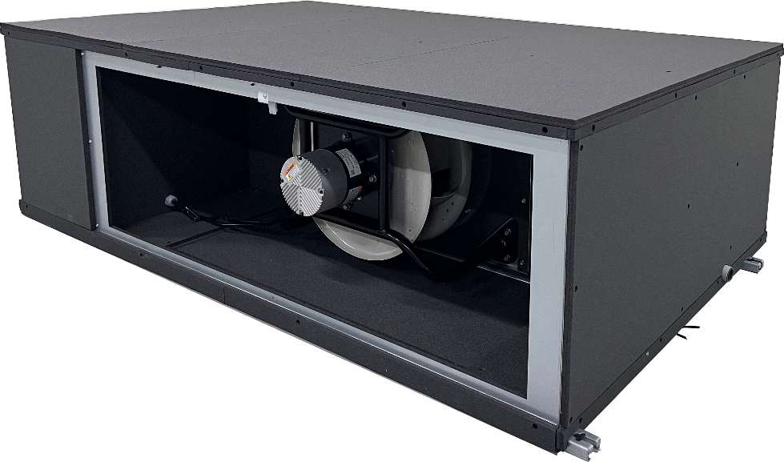
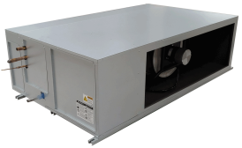
Contents
1. Introduction
1.0 Location of Key Parts
1.1 Location of Control Parts
1.2 Wiring Diagram
2. Trouble Shooting
2.1 Error Code Display
2.2 Error Code Table
2.3 Trouble Shooting
Insulation is attached to the outside of the product from the production on May.’22
Conventional (before May.’22)

Slide 4
Introduction

Slide 5
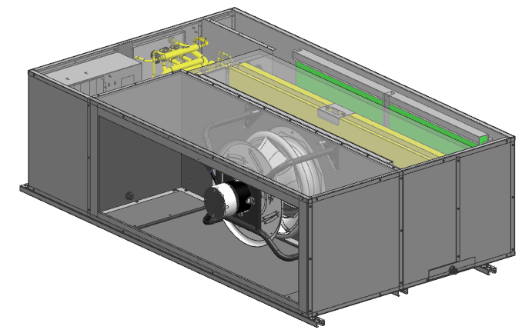
1.1 Location of Key Parts
1. Introduction
ARND153DCR4, ARND203DCR4
Drain Pump
Heat Recovery Unit
1 inch Insulation
Control Box
-Web UI,
-BACnet IP, Modbus RTU
Filters (2”, MERV 8)
Main Coil
Hot Gas Reheat Coil
Bottom Access Panel (Filter maintenance)
Bottom Access Panel
(Fan Motor Assembly)
Gravity Drain
3D Plug Fan
EC motor

Slide 6
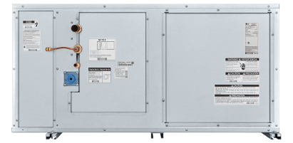
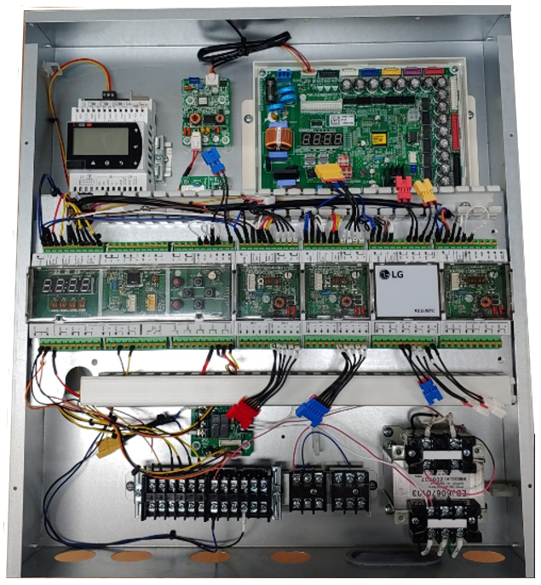
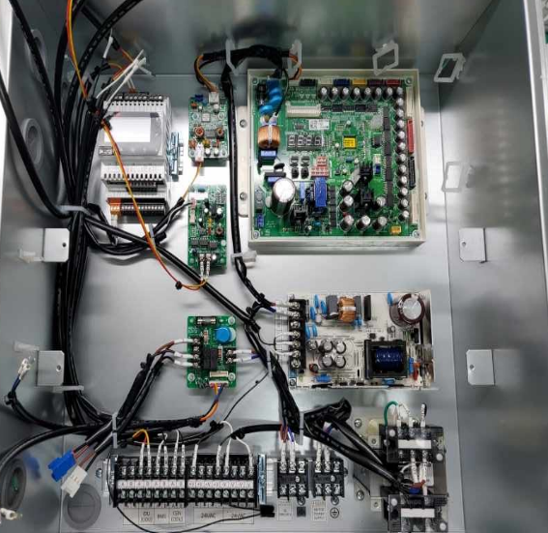
1.2 Location of Control Parts
1. Introduction
TOP PANEL
No | Description
1 | CAREL® Controller
2 | Main Module
3 | Main Coil EEV Module
4 | Reheat Coil EEV Module
5 | NTC Module
6 | UI Module
7 | HR Unit PCB
8 | SMPS
9 | Transformer
10 | RS485 1
11 | RS485 2
12 | Relay 1
2
3
4
5
6
BOTTOM PANEL
1
10
7
11
12
8
9

Slide 7
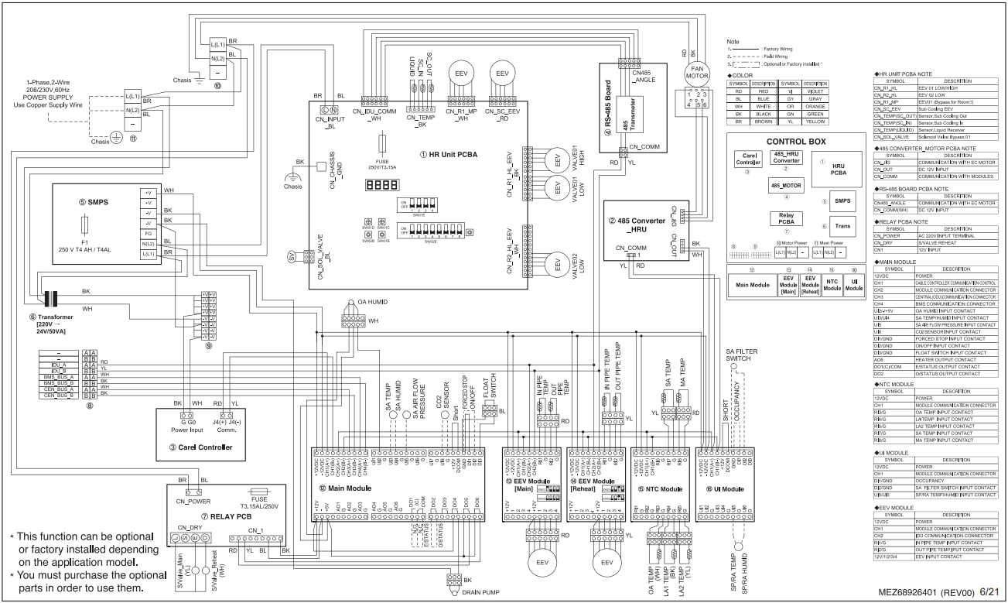
1.3 Wiring Diagram
1. Introduction
No | Description
1 | CAREL® Controller
2 | Main Module
3 | Main Coil EEV Module
4 | Reheat Coil EEV Module
5 | NTC Module
6 | UI Module
7 | HR Unit PCB
8 | SMPS
9 | Transformer
10 | RS485 1
11 | RS485 2
12 | Relay 1
10
7
8
11
9
1
2
3
4
5
6
12

Slide 8
Trouble Shooting

Slide 9
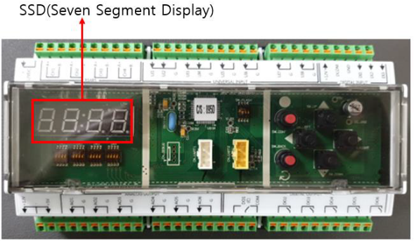
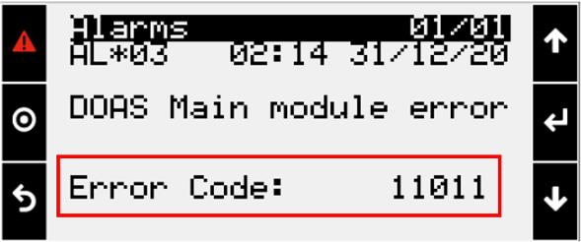
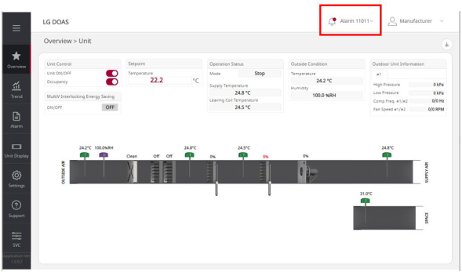
2.1 Error Code Display
2. Troubleshooting
Error Indicator
• There are two levels of error code response.
(1) Level 1 : Immediate system shutdown
(2) Level 2 : Notify and keep operation
Error Code Display
• Error codes are consist of 5 digits numbers. (Main module display right 4 digits only.)
[ Main Module ]
1
0
0 0 0
Error Occurrence Location
1 : DOAS system
2 : EEV Module
6 : ODU
7 : Supply Fan
8 : Exhaust Fan
9 : ERW
Error code
Error occurrence location
Fixed as 1
[ Carel Controller ]
• In case of EEV error (Second digit = 2),
1
2
0
0 0
Error code
EEV Module Location
1 : Main Coil
2 : Reheat Coil
3 : Recovery Coil
4 : Main Coil_2
EEV module location
EEV module
Fixed as 1
[ Web UI ]

Slide 10
2.2 Error Code Table
2. Troubleshooting
Category | Error Code | Level | Description | Details
Setting | 10001 | 1 | Need Product Setting | Product setting from Carel controller has not been set. Main module needs product information.
Forced Stop | 11001 | 1 | Forced Stop signal detection | When forced stop signal is detected for more than 3 seconds.
Drain Pump | 11002 | 1 | Float Switch or Drain Pump malfunction | Float Switch alarm is detected for more than 5 minutes.
Damper | 11003 | - | Reserved | Reserved
 | 11004 | - | Reserved | Reserved
 | 11005 | - | Reserved | Reserved
Filter | 11006 | 2 | Filter Alarm *if installed 3rd party Filter switch. | Differential pressure switch alarm for filter is detected.
 | 11007 | - | Reserved | Reserved
Communication | 11011 | 1 | Communication error with ODU (CEN A/B) | Central controller comm. Port (CEN A/B) of the ODU doesn’t respond for more than 3 minutes.
 | 11012 | 1 | ODU mismatch error | ODU is not compatible with DOAS system. (ODU main SW needs to be updated)
 | 11013 | 1 | Communication error with UI Module | Module doesn’t respond for more than 3 minutes.
 | 11014 | 1 | Communication error with NTC Module | Module doesn’t respond for more than 3 minutes.
 | 11015 | 1 | Communication error with fan communication board | Board doesn’t respond for more than 3 minutes.
 | 11021 | 1 | Communication error with EEV Module #1 (Main#1) | Module doesn’t respond for more than 3 minutes.
 | 11022 | 1 | Communication error with EEV Module #2 (Reheat) | Module doesn’t respond for more than 3 minutes.
 | 11023 | - | Reserved | Reserved
 | 11024 | - | Reserved | Reserved
Sensor | 11112 | 2 | OA Humidity sensor abnormal condition (UI #2) | Input voltage is less than 0.1V or more than 9.9V (for 3 minutes). - DOAS uses ODU humidity value as an alternative.
 | 11113 | 2 | SA Temperature sensor abnormal condition (UI #3) | Input voltage is less than 0.1V or more than 9.9V (for 3 minutes). - DOAS uses SA NTC sensor (RI#7) value as an alternative.
 | 11114 | 2 | SA Humidity sensor abnormal condition (UI #4) | Input voltage is less than 0.1V or more than 9.9V (for 3 minutes).
 | 11115 | 2 | SA differential pressure sensor abnormal condition (UI #5) | Input voltage is less than 0.1V or more than 9.9V (for 3 minutes).
 | 11116 | - | Reserved | Reserved
 | 11118 | 2 | CO2 sensor abnormal condition (UI #8) | Input voltage is less than 0.1V or more than 9.9V (for 3 minutes).
 | 11123 | 2 | Space Temp. sensor abnormal condition(UI #13) | Input voltage is less than 0.1V or more than 9.9V (for 3 minutes).
 | 11124 | 2 | Space Humid. sensor abnormal condition(UI #14) | Input voltage is less than 0.1V or more than 9.9V (for 3 minutes).

Slide 11
2.2 Error Code Table
2. Troubleshooting
Category | Error Code | Level | Description | Details
Sensor | 11131 | 2 | Space Temp. sensor abnormal condition(RI #1) | Input value is too low or too high (component open or short).
 | 11133 | 2 | OA Temp. sensor abnormal condition (RI #3) | Input value is too low or too high (component open or short). - DOAS uses ODU temperature sensor value as an alternative.
 | 11134 | 2 | LAT #1 Temp. sensor abnormal condition (RI #4) | Input value is too low or too high (component open or short). - DOAS uses LAT #2 value as an alternative.
 | 11135 | 2 | LAT #2 Temp. sensor abnormal condition (RI #5) | Input value is too low or too high (component open or short). - DOAS uses LAT #1 value as an alternative.
 | 11136 | - | Reserved | Reserved
 | 11137 | 2 | SA Temp. sensor abnormal condition (RI #7) | Input value is too low or too high (component open or short). - DOAS uses LAT (Leaving Air Temp.) value as an alternative.
 | 11138 | 2 | Mix Temp. sensor abnormal condition (RI #8) | Input value is too low or too high (component open or short).
EEV Module #1 (Main Coil #1) | 12102 | 1 | Pipe-In Temp. sensor abnormal condition on EEV Module #1 (Main #1) | Input value is too low or too high (component open or short).
 | 12105 | 1 | Communication error between EEV Module#1 (Main #1) and ODU | Communication with ODU is not performing properly.
 | 12106 | 1 | Pipe-Out Temp. sensor abnormal condition on EEV Module #1 (Main #1) | Input value is too low or too high (component open or short).
EEV Module #2 (Reheat Coil) | 12202 | 2 | Pipe-In Temp. sensor abnormal condition on EEV Module #2 (Reheat) | Input value is too low or too high (component open or short).
 | 12205 | 2 | Communication error between EEV Module#2 (Reheat) and ODU | Communication with ODU is not performing properly.
 | 12206 | 2 | Pipe-Out Temp. sensor abnormal condition on EEV Module #2 (Reheat) | Input value is too low or too high (component open or short).
ODU | 16xxx | 1 | Error occurrence on ODU | Display ODU error codes by using right 3 digit * Refer to the ODU SVC manual for detail information.
SA fan driver | 17021 | 1 | [EC Motor] IPM HW Fault | IPM HW Fault
 | 17023 | 1 | [EC Motor] DC Link Voltage abnormal | DC Link voltage is too low or too high
 | 17026 | 1 | [EC Motor] Missing cable connection | Motor internal cable is disconnected
 | 17029 | 1 | [EC Motor] IPM over current | Motor driving current is too high
 | 17040 | 1 | [EC Motor] IPM current detection parts abnormal | Bad component on current detection
 | 17052 | 1 | [EC Motor] Communication error | Fan communication PCBA doesn’t receive response form the EC Motor for 30 seconds
 | 17057 | 1 | [EC Motor] Communication error | EC Motor doesn’t receive command for more than 3 minutes.
 | 17062 | 1 | [EC Motor] IPM Heatsink Temp abnormal | Heatsink Temp is over the spec
 | 17067 | 1 | [EC Motor] Motor Lock | Fan Motor is locked

Slide 12
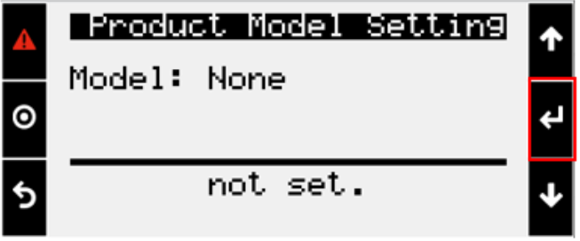
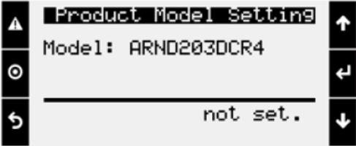
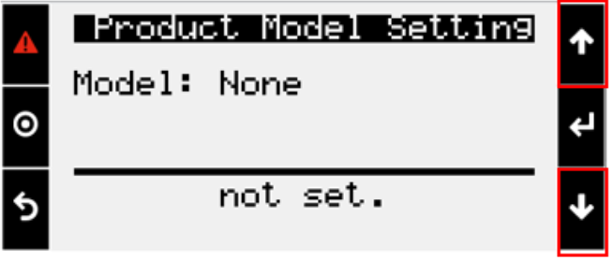
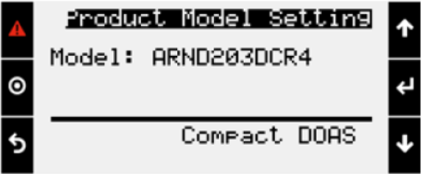
2.3 Trouble Shooting
2. Troubleshooting
Error No. 10001
• Symptom : System shutdown with displaying error code 0001 on the main module SSD. (10001 on the Carel controller or Web UI)
• Cause : When the new Carel controller is replaced as a service activity and it need the product information.
• Trouble shooting : Conduct initial product setting.
1. Push the Enter button at the model setting screen.
3. Push the enter button
2. Search installed model No. using up and down button
4. Check the model No. and model type
If you set wrong model No you can change it with below sequence
Menu → Ctrl. Variable → Advanced → Login → Set Password “7600” and push Enter Button.
Then Go to Menu again → Settings → DOAS Model Setting → and set the correct model name.

Slide 13
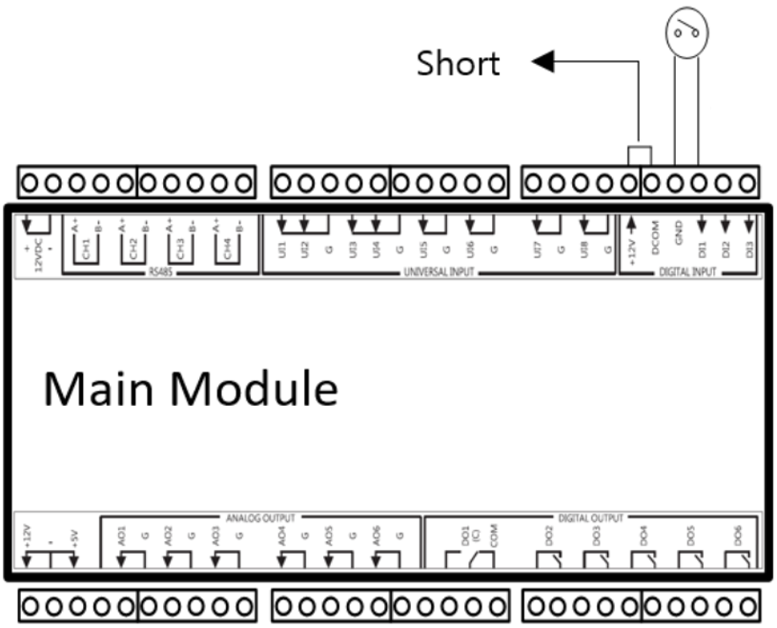
2.3 Trouble Shooting
2. Troubleshooting
Error No. 11001
• Symptom : System shutdown with displaying code 1001 on the main module SSD. (11001 on the Carel controller or Web UI)
• Cause : The forced stop input is opened.
• Trouble shooting : Conduct initial product setting.
1. Check the 12V and DCOM is shorted.
2. Check the forced stop input is opened.
- The input signal from forced stop device should be normal closed type and dry contact output.
Forced Stop Input
DI1 - GND
Short

Slide 14
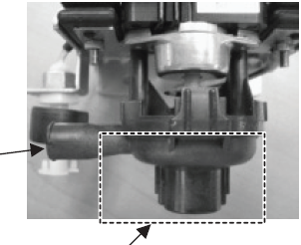
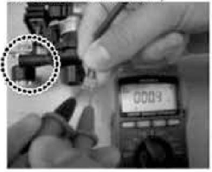
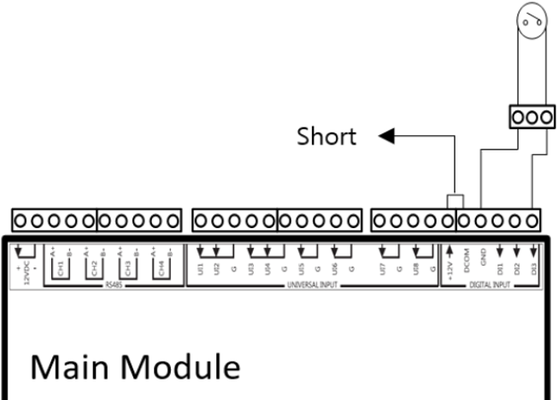
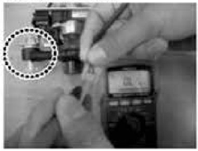
2.3 Trouble Shooting
2. Troubleshooting
Error No. 11002
• Symptom : System shutdown with displaying code 1002 on the main module SSD. (11002 on the Carel controller or Web UI)
• Cause : The float switch is opened due to rising of condensate water level, drain pump fault or drain pipe clogging
• Trouble shooting
[Float Switch Check]
- Follow the flow chart.
Is a drain pan filled half-way with water?
No
Is the output of the float switch shorted?
No
Replace float switch
Yes
Float Switch
Yes
Check connection or
Replace main module
Is drain pipe clogged?
No
Check the slope of the
drain pan.
Condensate Water
Yes
[Float Switch Connection]
Float Switch Input
DI3 - GND
Low Position = Short → 0 ohm
Clean the pipe
High Position = Open

Slide 15
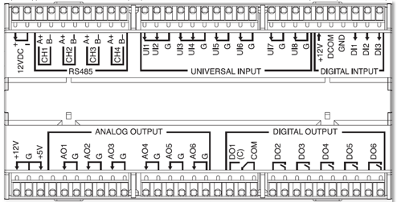
2.3 Trouble Shooting
2. Troubleshooting
Error No. 11006
• Symptom : System keeps operating with displaying code 1006 on the main module SSD. (11006 on the Carel controller or Web UI)
• Cause : Pressure switch for the filters is activated.
• Trouble shooting : Check the filter condition
• Note : Differential Pressure switch for filter is not default(Factory Assembled), Need to buy and install 3rd party D/P Switch.
3rd party Differential Pressure Switch for filter
Check if there is any blockage on the filter
- It is recommended to check the filter once a month.
2. Clean or replace the filter if necessary.

Slide 16
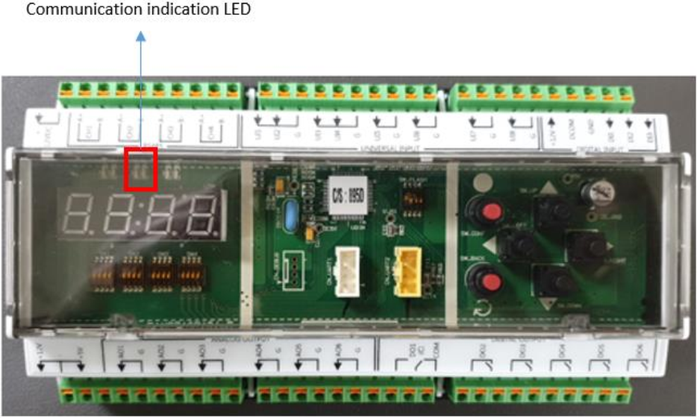
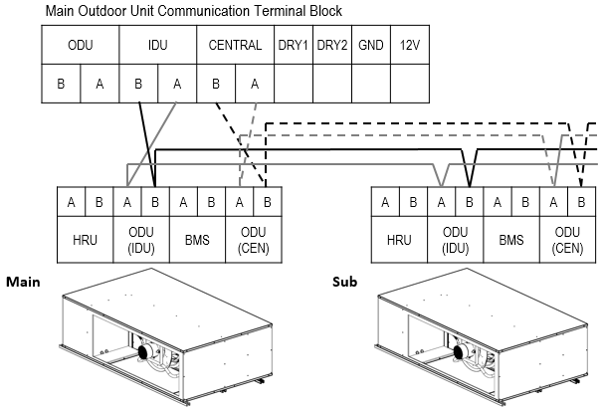
2.3 Trouble Shooting
2. Troubleshooting
Error No. 11011
• Symptom : System shutdown with displaying code 1011 on the main module SSD. (11011 on the Carel controller or Web UI)
• Cause : The outdoor unit does not respond to DOAS command for 3 minutes.
• Trouble shooting
1. Check the Communication Indication LED
- It will blink as often as transmission and reception is happened.
- Green LED indicates transmission and yellow LED indicates reception from the main module.
2. Check the connection with outdoor units based on the wiring diagram
[Communication Indication LED]
[Wiring Diagram]

Slide 17
2.3 Trouble Shooting
2. Troubleshooting
Error No. 11012
• Symptom : System shutdown with displaying code 1012 on the main module SSD. (11012 on the Carel controller or Web UI)
• Cause : The outdoor unit is not compatible with DOAS system due to version mismatch.
• Trouble shooting
1. Check the outdoor unit production date
2. Update the main PCBA software of the outdoor unit
-. Compact DOAS Application with MV 5 system is available after SW version 1.47.0
ODU SW Version | SW Check Sum | Description | Production Date (ODU)
v1.49.0 | 2291 | 1. LG DOAS function updated ▪ LG Compact DOAS model can be connected to ODU. ▪ Model: ARND203DCR4, ARND153DCR4, ARND093DCR4 | `21. 6. 3 (2107)

Slide 18
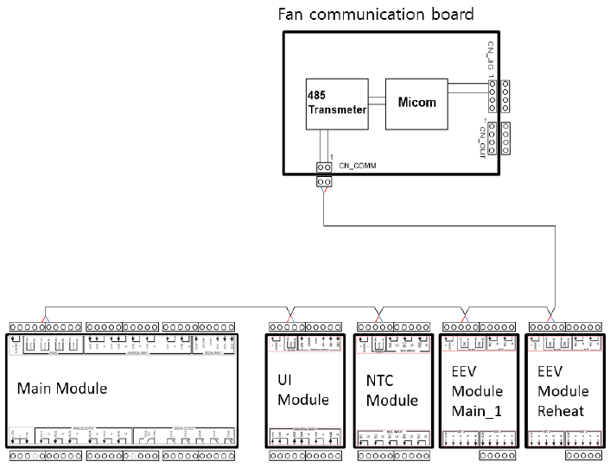
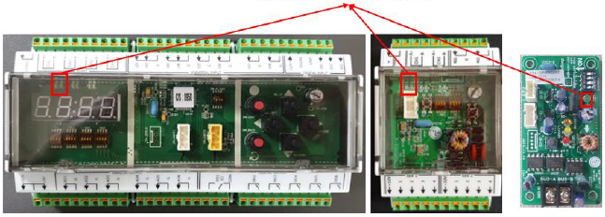
2.3 Trouble Shooting
2. Troubleshooting
Error No. 11013 / 11014 / 11015 / 11021 / 11022 / 11023 / 11024
• Symptom : System shutdown with displaying code below on the main module SSD (Carel controller or Web UI).
• Cause : The module inside control box does not respond to DOAS command for 3 seconds.
• Trouble shooting
1013 (11013) : UI module
1014 (11014) : NTC module
1015 (11015) : Fan communication board
1021 (11021) : Main_1 EEV module
1022 (11022) : Reheat EEV module
[Wring Diagram]
Check the Communication Indication LED on each module.
Main Module / UI Module / NTC Module / EEV Module
- It will blink as often as transmission and reception is happened.
- Green LED indicates transmission and yellow LED indicates reception from the main module.
Fan PCB
- One Green LED Blinks when it transmits data.
2. Check the connection with the modules based on the wiring diagram
[Communication Indication LED]
Main Module
UI / NTC / EEV
Module
Fan CM
Board

Slide 19

2.3 Trouble Shooting
2. Troubleshooting
Error No. 11112 / 11113 / 11114 / 11115 / 11118 / 11123 / 11124
• Symptom : System keeps operating with displaying code below on the main module SSD (Carel controller or Web UI).
1112 (11112) : OA humidity (Factory assembled)
1113 (11113) : SA temperature (3rd party installation)
1114 (11114) : SA humidity (3rd party installation)
1115 (11115) : Differential pressure Sensor(3rd party installation)
1118 (11118) : CO2 Sensor (3rd party installation)
1123 (11123) : Space temperature (3rd party installation)
1124 (11124) : Space humidity (3rd party installation)
• Cause : The 0~10V voltage type sensor’s input is not readable. (less than 0.1V or more than 9.9V)
If only the Sensor setting on Web UI(Configuration) was set to "Installed" without sensors.
• Trouble shooting
1. In case of the 3rd party sensor installation, match the configuration on the Web UI.
- If the sensors are not installed, the ‘Installed’ item on the configuration should set as Gray which is meaning “ Not Installed”
(e.g. Space Humidity Sensor setting on Web UI)
- Sensor is NOT installed -
- Sensor is installed -
2. Check the power supply to the sensor and sensor signal by using multi-tester.
- If the voltage is not normal, pull out the signal cable from the module and check again.

Slide 20
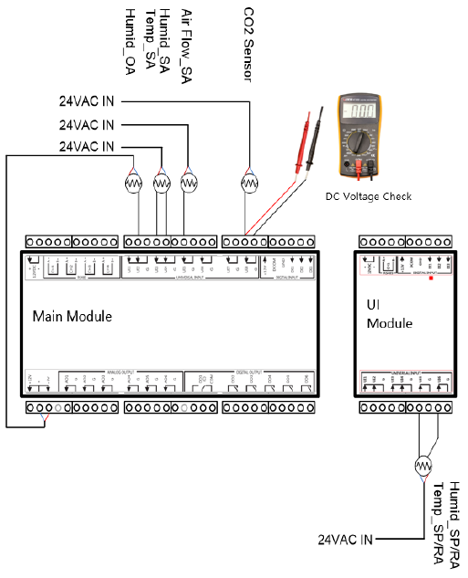
2.3 Trouble Shooting
2. Troubleshooting
Error No. 11112 / 11113 / 11114 / 11115 / 11118 / 11123 / 11124
[Wiring Diagram for 0~10V type Sensor]
1. Is 24VAC power supplied to the sensor?
2. Check the sensor signal by using multi-tester.
3. If voltage is less than 0.1V or more than 9.9V, then pull out the signal
cable from the Main or UI module and check again without external
disturbance.

Slide 21
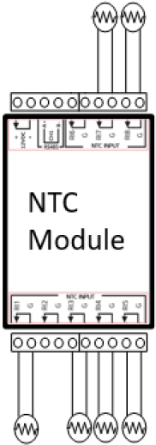
2.3 Trouble Shooting
2. Troubleshooting
Error No. 11131 / 11133 / 11134 / 11135 / 11137 / 11138
• Symptom : System keeps operating with displaying code below on the main module SSD (Carel controller or Web UI).
1131 (11131) : Space temperature (3rd party installation)
1133 (11133) : OA temperature (Factory Assembled)
1134 (11134) : Main coil leaving air temperature_1 (Factory Assembled)
1135 (11135) : Main coil leaving air temperature_2 (Factory Assembled)
1137 (11137) : SA temperature (Factory Assembled)
1138 (11138) : Mix temperature (Factory Assembled)
SA_Temp
Mix_Temp
• Cause : The sensor connected to NTC module has a fault.
• Trouble shooting
1. Check the connection to the NTC module.
2. Check the sensor resistance.
a) Disconnect sensor wiring from NTC module
b) Set the multi-tester to resistance mode
c) Measure the resistance at the sensor outlet
d) If the value is more than 100kohm or less than 100ohm, sensor needs to be replaced.
※ Normal Value
- 10kohm at 77⁰F with ±5% tolerance
- 20kohm at 77⁰F
- 3.4kohm at 122⁰F
SP/RA_Temp
Leaving_Temp_2
Leaving_Temp_1
OA_Temp

Slide 22
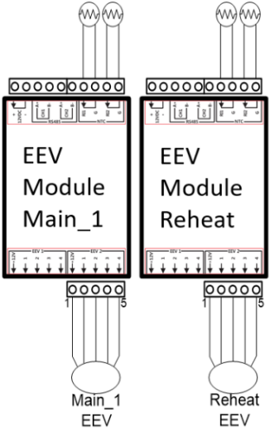
2.3 Trouble Shooting
2. Troubleshooting
Error No. 12102 / 12106 / 12202 / 12206
• Symptom : System shutdown or keeps operating with displaying code below on the main module SSD (Carel controller or Web UI).
Shutdown
2102 (12102) : Pipe-In temperature of Main Coil #1
2106 (12106) : Pipe-Out temperature of Main Coil #1
Keep Operating
2202 (12202) : Pipe-In temperature of Reheat Coil
2206 (12206) : Pipe-Out temperature of Reheat Coil
[NTC 5kohm sensor]
Pipe Out
Pipe Out
Pipe In
Pipe In
• Cause : Refrigerant temperature sensors connected to EEV module has a fault.
• Trouble shooting
1. Check the connection to the EEV module.
2. Check the sensor resistance.
a) Disconnect sensor wiring from NTC module
b) Set the multi-tester to resistance mode
c) Measure the resistance at the sensor outlet
d) If the value is more than 100kohm or less than 100ohm, sensor needs to be replaced.
※ Normal Value
- 5kohm at 77⁰F with ±5% tolerance
- 10kohm at 77⁰F
- 1.8kohm at 122⁰F

Slide 23
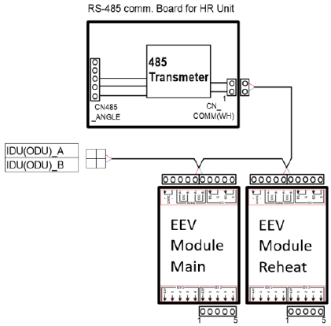
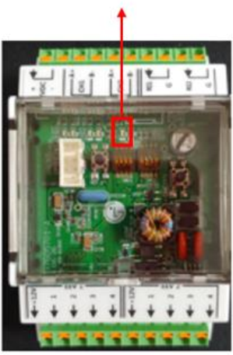
2.3 Trouble Shooting
2. Troubleshooting
Error No. 12105 / 12205 /
• Symptom : System shutdown or keeps operating with displaying code below on the main module SSD (Carel controller or Web UI).
Shutdown
2105 (12105) : Communication error between ODU and Main Coil #1
Keep Operating
2205 (12205) : Communication error between ODU and Reheat Coil
• Cause : EEV modules do not communicate with outdoor unit.
• Trouble shooting
1. Check the communication indication LED (5th from the left) on the EEV module.
- When this green LED blinks, EEV module transmits data. (Communication speed is 1200bps.)
[Wiring Diagram]
2. Check the connection of the wiring for communication with ODU.
[Communication Indication LED]
[EEV Module]
[Internal Wiring Diagram for communication with ODU]

Slide 24
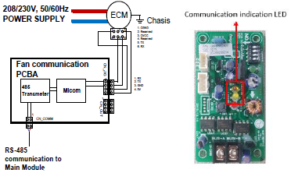
2.3 Trouble Shooting
2. Troubleshooting
Error No. 170xx (SA fan driver fault)
Error Code | Level | Cause | Defect Assumption | Trouble Shooting
21 | 1 | IPM HW Fault |  | EC Motor is integrated with Inverter PCB Needs to exchange EC Motor assembly
23 | 1 | DC Link voltage is too low or too high
26 | 1 | Motor internal cable is disconnected
29 | 1 | Motor driving current is too high
40 | 1 | Bad component on current detection
52 | 1 | Fan communication PCBA doesn’t receive response from the EC Motor for 30 seconds | Losing communication or PCBA fault | There are Orange and Yellow LEDs indicate communication status. Orange will blink when fan communication PCBA transmits data to EC Motor and Yellow will blink when response is happened. (For this RS-232 communication, fan communication PCBA is master and EC motor is slave.)
57 | 1 | EC Motor doesn’t receive command for more than 3 minutes. |  | EC Motor is integrated with Inverter PCB Needs to exchange EC Motor assembly
62 | 1 | Heatsink Temp is over the spec
67 | 1 | Fan Motor is locked |  | Check if error occur after power reset Check whether fan blade is locked and fan blade turn smoothly when turned by hand

